Slide 1


Financial Conflict of Interest
Reporting Requirements and a Demonstration of the eRA Commons FCOI Module
August 14, 2012
Office of Extramural Research
National Institutes of Health, HHS
Scarlett Gibb, Customer Relationship Manager, eRA Commons
Kathy Hancock, Assistant Grants Compliance Officer

Slide 2


Presenters
Kathy Hancock
NIH Assistant Grants Compliance Officer
Scarlett Gibb
NIH Customer Relationship Manager, eRA Commons

Slide 3
Summary of Topics
What to report?
How to report?
Changes to the eRA Commons FCOI Module
Types of Reports & Other Actions to be taken related to FCOI
Live Demonstration of the FCOI Module

Slide 4
Financial Conflict of Interest (FCOI)
Regulations
42 CFR Part 50 Subpart F (grants and cooperative agreements)
45 CFR Part 94 (contracts)
      Revised Final Rule published on 8-25-11
      http://www.gpo.gov/fdsys/pkg/FR-2011-08-25/pdf/2011-21633.pdf
      Regulation for 42 CFR Part 50 Subpart F
      http://ecfr.gpoaccess.gov/cgi/t/text/text-idx?c=ecfr&sid=f67ea01984581d3934103b5074c05500&rgn=div5&view=text&node=42:1.0.1.4.22&idno=42#42:1.0.1.4.22.6

Slide 5
2011 Revised FCOI Regulation
Implementation by August 24, 2012
Applies to each Notice of Award (NoA) that is issued on or after 8/24/2012
  Not retroactive
  Important in considering compliance with the regulation
Example:
On going awards or FY 2012 awards issued PRIOR to 8/24/2012 are subject to 1995 regulation.
  Awards issued ON or AFTER 8/24/2012 are subject to the 2011 revised regulation, regardless of the budget period start date. This excludes any awards extended without funds that were previously subject to 1995 regulation.

Slide 6
What do Institution’s Report to NIH?
Institutions report Identified FCOIs for its
  Investigators and
  Subrecipient Investigators, if applicable

Slide 7
What is an FCOI?
A Significant Financial Interest (SFI) that an Investigator or subrecipient Investigator has (including their spouse and dependent children) that could directly and significantly affect the design, conduct, or reporting of NIH-funded research.

Slide 8
How are FCOI Reports submitted to NIH?
Electronic Research Administration (eRA) Commons FCOI Module –
FCOI Reporting Tool
FCOI Module accessed via
eRA Commons

Slide 9
What are the features of the FCOI Module?
The FCOI Module allows Institutions to:
Electronically submit FCOI reports and supporting documentation
Submit a New (initiate 2011 FCOI report), Annual, and Revised FCOI reports and a Mitigation report
Search and view FCOI reports and associated data previously submitted through Commons
Receive an email confirmation that NIH received the report.
Submit additional information when requested by NIH.
Receive email reminders when an annual FCOI report is due.

Slide 10
How to get access to the FCOI Module?
Institutional Signing Officials assign FCOI roles to users in eRA Commons.
  FCOI Role
  FCOI ASST
  FCOI View only role
More information on the FCOI Module can be found at
  http://era.nih.gov/services_for_applicants/other/fcoi.cfm

Slide 11
What additional information is required in a 2011 FCOI Report?
FCOI Module is designed to collect the following additional information per the regulation:
The name of the entity with which the Investigator has an FCOI;
  Entity name is entered in a text box.
Nature of the Significant Financial Interest (SFI);
  The SFI information will be selected from a drop down menu.

Slide 12
What additional information is required under a 2011 FCOI Report?
Value of the SFI;
  The Value of SFI will be selected from a drop down menu.
Description via text box or uploaded PDF of how the financial interest relates to NIH-funded research and why the Institution determined that the financial interest conflicts with such research; and

Slide 13
What additional information is required under a 2011 FCOI Report?
Description of the key elements of the Institution’s management plan, including other required information.
  Information submitted via text box or uploaded PDF file

Slide 14
What are the Key Elements of a Management Plan?
Key Elements of a Management Plan include:
  Role and principal duties of the conflicted Investigator in the research project;
  Conditions of the management plan;
  How the management plan is designed to safeguard objectivity in the research project;
  Confirmation of the Investigator’s agreement to the management plan;
  How the management plan will be monitored to ensure Investigator compliance; and
  Other information as needed.

Slide 15
What additional information is required under a 2011 FCOI Report?
Verification that the Institution is submitting an FCOI report that is in compliance with the 2011 revised regulation.
  Does this FCOI report include a failure to comply with the FCOI regulation?

Slide 16
How is “noncompliance with regulation” defined?
  An FCOI is not identified or managed in a timely manner, for any of the following reasons:
    failure by the Investigator to disclose an SFI,
    failure by the Institution to review or manage an FCOI, or
    failure to comply with the management plan

Slide 17
What happens when the Institution submits an FCOI report that includes noncompliance?
In situations of noncompliance, the FCOI Module will allow the Institution to:
  Address whether the Retrospective Review was completed;
  Submit a Mitigation Report when bias is found following the completion of the Retrospective Review; and
  Submit a Revised FCOI Report, if needed, to update the previously submitted FCOI information or specify the actions that will be taken to manage the FCOI going forward.

Slide 18
REQUIRED FCOI REPORTS TO BE PROVIDED TO NIH THROUGH eRA COMMONS FCOI MODULE
Report | Content | Required when?
New FCOI Report (Initial submission) | Grant Number, PI, Name of Entity with FCOI, Nature of FCOI, Value of financial interest (in increments), Description of how FI relates to research, Key Elements of Management Plan. | Prior to expenditure of funds Within 60 days of any subsequently identified FCOI
Annual FCOI Report | Status of FCOI (i.e., whether FCOI is still being managed or no longer exists) and Changes to Management Plan, if applicable | Annual report due at the same time as when the Institution is required to submit annual progress report, multi-year progress report, or at time of extension.
Revised FCOI Report | If applicable, update a previously submitted FCOI report to describe actions that will be taken to manage FCOI going forward or make changes to originally submitted FCOI report. | Following the completion of a retrospective review when there is noncompliance with the regulation, if needed.
Mitigation Report | Project Number, Project Title, Contact PI/PD, Name of Investigator with FCOI, Name of Entity with FCOI, Reason for review, Detail Methodology, Findings and Conclusion. | When bias is found as a result of a retrospective review.

Slide 19
How to Get Started?
Initiate 2011 FCOI Report

Slide 20
How to Submit an FCOI Report for the first time?
Choose - Initiate 2011 FCOI Report
Used for reporting FCOIs for the first time under a competing or noncompeting award
Provides the details of the FCOI report as required under 2011 revised regulation
FCOI reports submitted thereafter are “Annual” reports for any future year within the same competitive segment.

Slide 21
When to Submit an FCOI Report?
(Reporting Requirements)
Provide initial and ongoing FCOI reports to NIH:
  Prior to the expenditure of funds under a NIH-funded research project
  During the period of award
    Within 60 days of identifying a new FCOI
  Annually

Slide 22
When NOT to submit an
FCOI report?
FCOI report is not required if the conflicting interest is eliminated prior to the expenditure of NIH awarded funds.

Slide 23
ANNUAL
FCOI REPORT

Slide 24
When to Submit an Annual FCOI Report?
(Reporting Requirements)
The Annual FCOI Report is due
          At the same time as when the Institution is required to submit the annual progress report, including multi-year progress report, or at time of extension.

Slide 25
When are Annual Reports submitted?
Annual Reports are submitted following the submission of a fully detailed FCOI Report (Initiate 2011 FCOI Report)
FCOIs previously reported under the 1995 regulation that no longer exist by the FCOI report due date do not require an annual report.
NIH staff may request information on previously submitted FCOIs through the eRA Commons.

Slide 26
What information is required in an Annual FCOI Report?
  After submitting an Initial 2011 FCOI Report, an Annual Report will address the status of the FCOI during the current competitive segment.
    FCOI Module Question:
    “Does the FCOI still exist?”
      If “No”, provide an explanation in a text box or upload a PDF attachment.
      If “No”, FCOI report is removed from future reporting requirements.

Slide 27
What information is required in an Annual FCOI Report?
  After submitting an Initial 2011 FCOI Report, an Annual Report will address the status of the FCOI during the current competitive segment.
    FCOI Module Question:
      “Does the FCOI still exist?”
      If “Yes” – “Are there any changes to the management plan?”
        If yes, provide information in a text box or upload a PDF attachment.

Slide 28
Mitigation Report

Slide 29
What is a Mitigation Report?
Only required when bias is found in the design, conduct or reporting of NIH-funded research following a Retrospective Review.
Describes the Institution's plan of action or actions taken to eliminate or mitigate the effect of the bias.

Slide 30
What to include in a Mitigation Report?
Mitigation Report must include the following information:
Key elements documented in the Retrospective Review.
Description of the impact of the bias on the research project
Institution’s plan of action or actions taken to eliminate or mitigate the effect of the bias

Slide 31
How to Submit a Mitigation Report?
FCOI Module allows the Mitigation Report to be submitted as follows:
Via a text box or PDF upload
With Initial FCOI Report if the Retrospective Review is complete or
Through a “Revised” FCOI Report upon completion of the Retrospective Review

Slide 32
Revised FCOI Report

Slide 33
When is a Revised FCOI Report required?
A Revised Report is used to:
To submit a Mitigation Report when bias is found

Slide 34
When is a Revised FCOI Report required?
A Revised Report is used:
When the Institution discovers new information following the Retrospective Review that changes a previously submitted FCOI report. For example:
  An increase in value of a previously reported SFI
  To report a change to the management of the FCOI from what was previously reported under the previously submitted FCOI report.

Slide 35
Summary of FCOI Noncompliance and FCOI Reporting
FCOI REPORT (within 60 days)
Whenever an Institution identifies an SFI that was not disclosed, identified, reviewed or managed in a timely manner, the designated official(s) shall within 60 days: review and make the determination of an FCOI and report the FCOI, if it exists, to the PHS/NIH.
RETROSPECTIVE REVIEW (to determine bias)
If an FCOI exists, complete and document a retrospective review within 120 days of the Institution’s determination of noncompliance. Implement, on at least an interim basis, a management plan that shall specify the actions that have been, and will be, taken to manage the FCOI going forward.
UPDATE/REVISE FCOI REPORT (following retrospective review)
If applicable, update existing FCOI report to specify the actions that have been, and will be, taken to manage the FCOI going forward or update previously submitted report.
MITIGATION REPORT (promptly after retrospective review)
If bias is found, notify NIH promptly
Submit mitigation report through FCOI Module
ANNUAL FCOI REPORT
Submit annual FCOI report thereafter through FCOI Module

Slide 36
“Rescind” a Previously Submitted FCOI Report

Slide 37
Rescinded FCOI Reports
FCOI Reports submitted in error may be “rescinded”. Examples include:
  Submission of a duplicate report
  Incorrect name of the Investigator with FCOI
  Incorrect name of the entity
NIH will use the “rescind” feature when an incomplete report is submitted

Slide 38
What to do when the Institution needs to Rescind an FCOI Report?
FCOI report submitted in error?
  Contact the Grants Management Specialist (GMS) noted on the most recent Notice of Award (NoA)
  Request the IC to rescind the report, and
  Provide an explanation why the report should be rescinded.

Slide 39
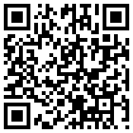
Information/Resources
NIH Office of Extramural Research FCOI Web Site
  http://grants.nih.gov/grants/policy/coi/
  Some Resources include:
  A tutorial, webinar, PowerPoint presentations
  FAQs are periodically updated and will be updated soon.
    http://grants.nih.gov/grants/policy/coifaq.htm

Slide 40
LIVE DEMONSTRATION
eRA COMMONS
FCOI MODULE

Slide 41
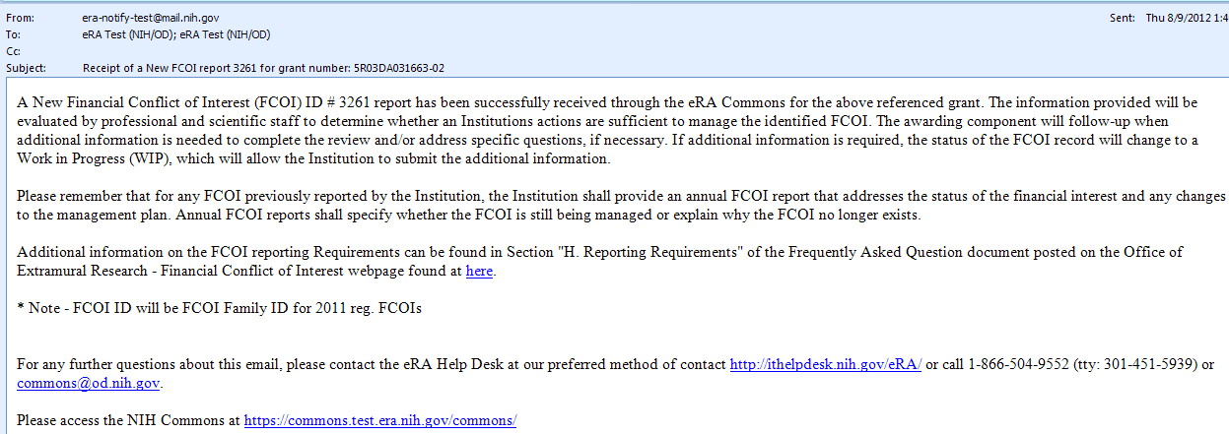
Receipt of FCOI Report by the NIH (New)

Slide 42
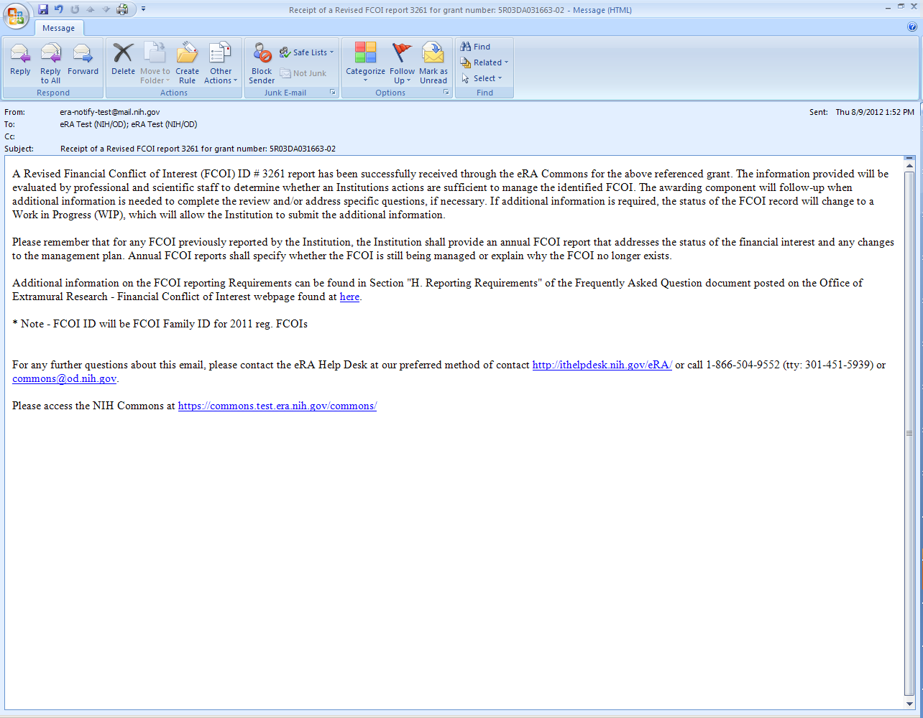
Receipt of FCOI Report by the NIH (Revised)

Slide 43
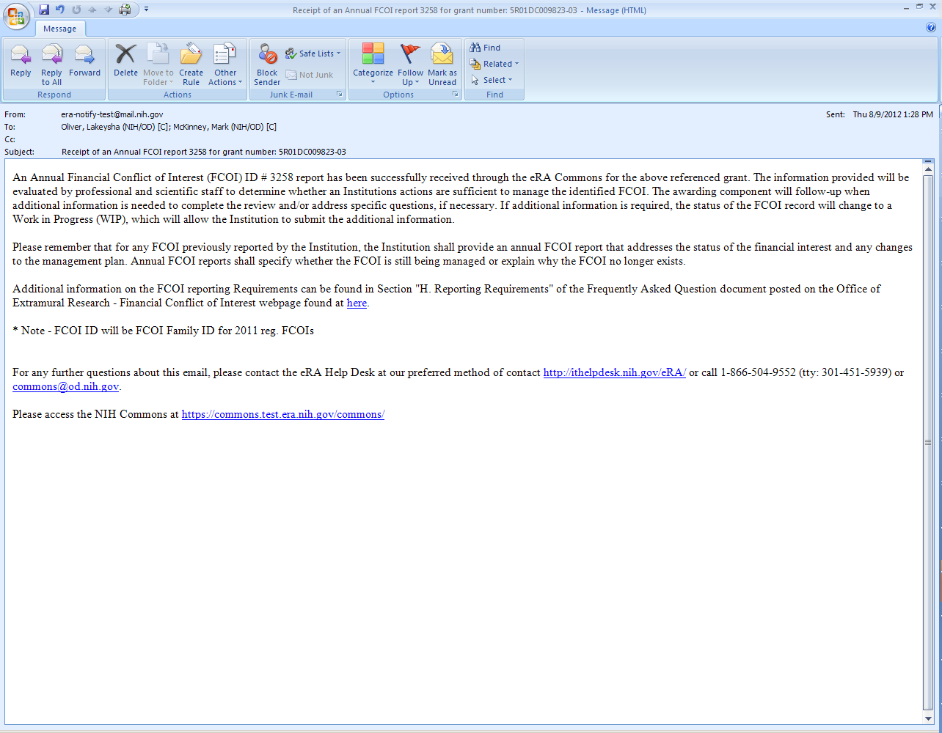
Receipt of FCOI Report by the NIH (Annual)

Slide 44
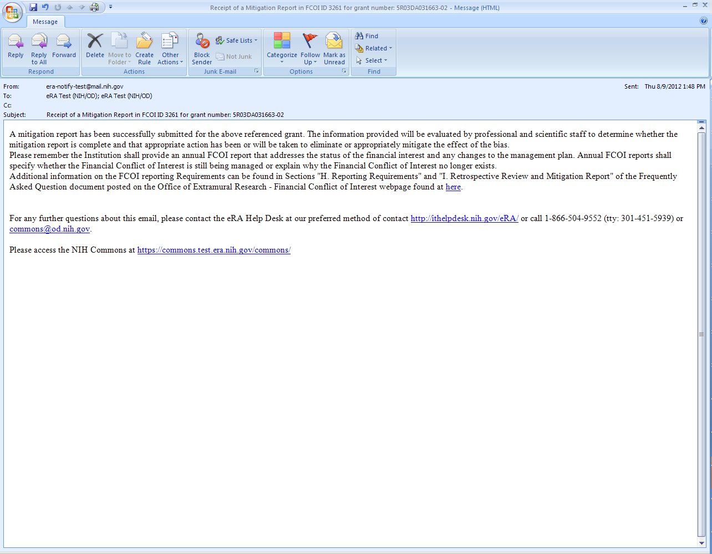
Receipt of Report by the NIH
(Mitigation)

Slide 45
Q&A Panel
Kathy Hancock
NIH Assistant Grants Compliance Officer
Scarlett Gibb
NIH Customer
Relationship Manager,
eRA Commons

Slide 46
Questions?
For questions regarding the FCOI regulation, please contact:
Kathy Hancock
Assistant Grants Compliance Officer
Division of Grants Compliance and Oversight, OPERA, OER
301-435-1962
kathy.hancock@nih.gov
General FCOI Inquiries: FCOICompliance@mail.nih.gov
For questions regarding FCOI Module contact:
eRA Commons Help Desk
Web: grants.nih.gov/support (Preferred method of contact)
Toll-free: 1-866-504-9552
Phone: 301-402-7469
Hours: Mon.-Fri., 7a.m. to 8 p.m. Eastern Standard Time

